Slide 1
SPM Thresholds and the data used to support them.
By: Owen Gaustad

Slide 2
The Big Peeps
Mollie Orshansky
First Poverty Threshold Equation
Thesia I. Garner
--Senior Research Economist. Bureau of Labor Statistics
David Betson
--Associate Professor of Public Policy and Economics

Slide 3
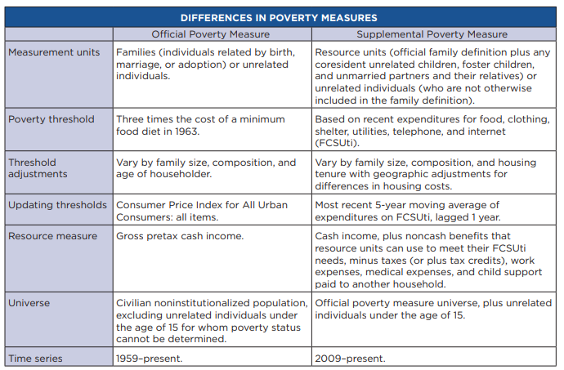

Slide 4
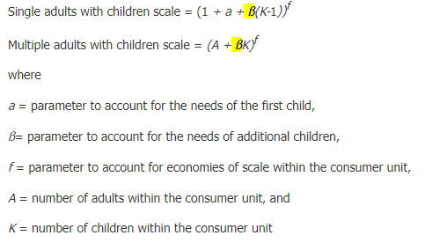
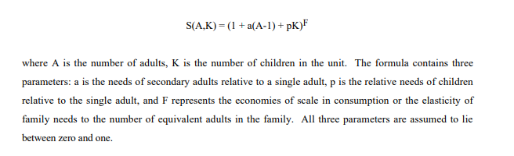
Where the Numbers come from.
The previously published Research SPM thresholds were based on a range of FCSU expenditures centered on the 33rd percentile using data from an estimation sample composed of consumer units with exactly two children and any number of adults. These expenditures were equalized to the spending of a consumer unit with two adults and two children using the three-parameter equivalence scale proposed by Betson (1996).
The parameters Betson estimated a, ß, and f to fit the literature on the cost of children, and when rounded, were 0.8, 0.5, and 0.7, respectively.
David Betson, University of Notre Dame.

Slide 5
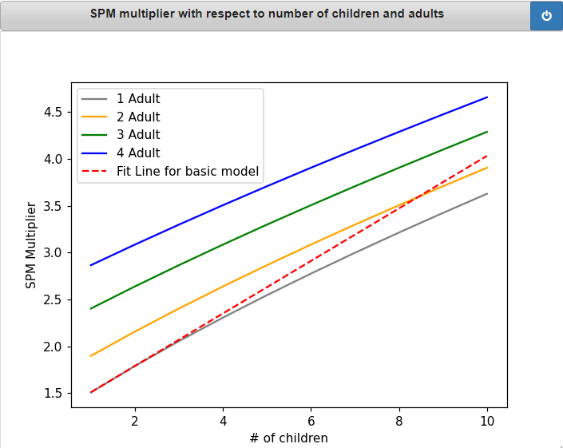
What the equations look like.
This is a version of a logarithmic graph.
This is the SPM Multiplier

Slide 6
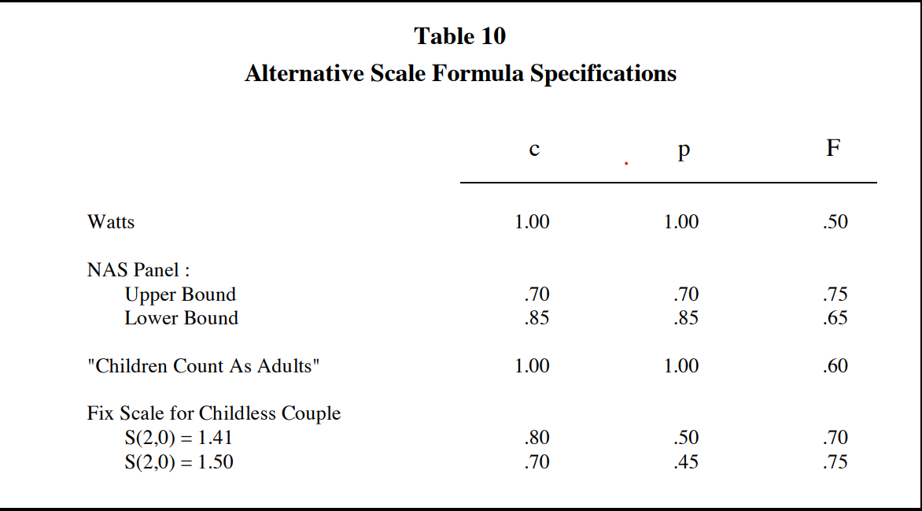
Other options according to Betson

Slide 7
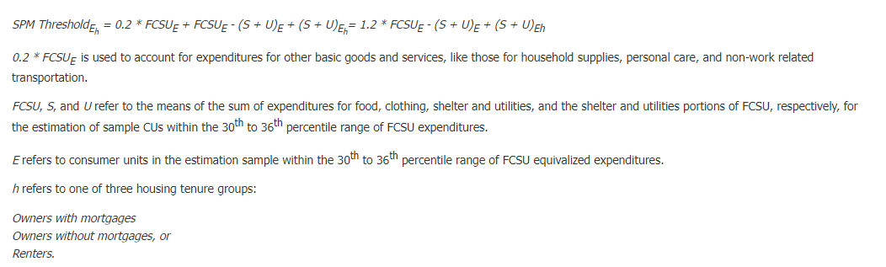
What are the multipliers used for?
A calculated SPM multiplier is then used to calculate your SPM threshold with another convoluted equation.

Slide 8
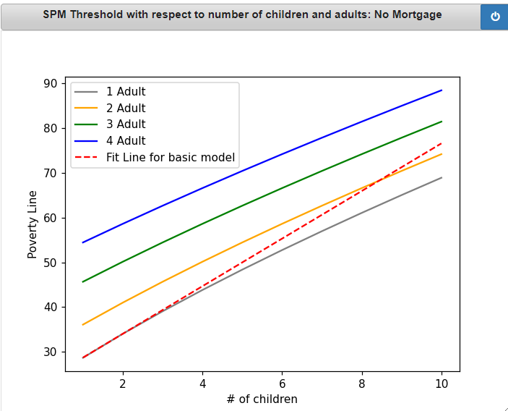
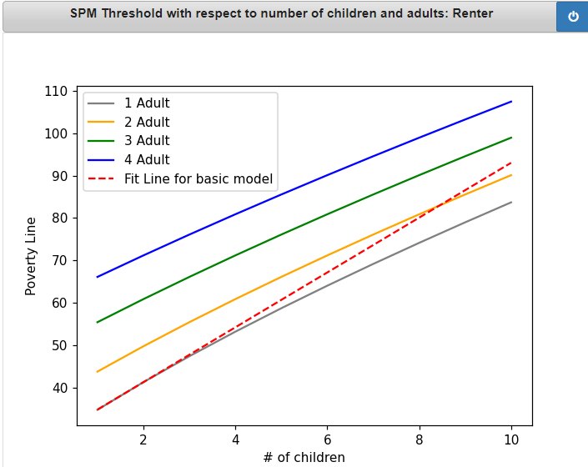
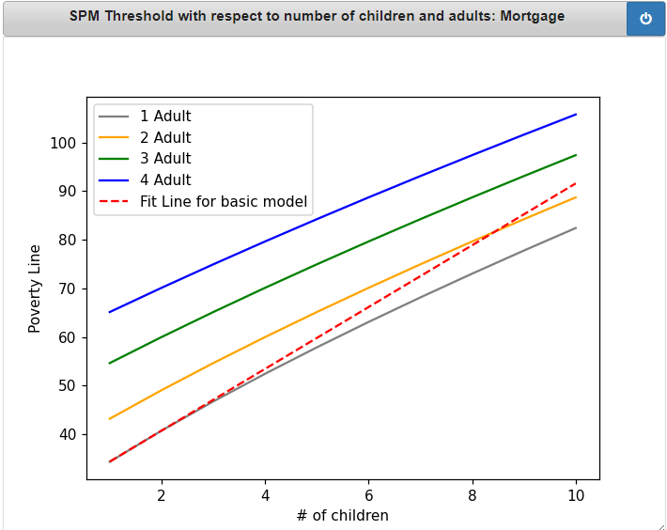

Slide 9
Look into it
Experimental Poverty Measures : U.S. Bureau of Labor Statistics (bls.gov)
escale.pdf (census.gov)

